Slide 1

Chapter 6
Low-Level Programming Languages and Pseudocode

Slide 2
Chapter Goals
List the operations that a computer can perform
Describe the important features of the Pep/8 virtual machine
Distinguish between immediate addressing mode and direct addressing mode
Write a simple machine-language program
Distinguish between machine language and assembly language

Slide 3
Chapter Goals
Describe the steps in creating and running an assembly-language program
Write a simple program in assembly language
Distinguish between instructions to the assembler and instructions to be translated
Distinguish between following an algorithm and developing one
Describe the pseudocode constructs used in expressing an algorithm

Slide 4
Chapter Goals
Use pseudocode to express an algorithm
Describe two approaches to testing
Design and implement a test plan for a simple assembly-language program

Slide 5
Computer Operations
Computer
A programmable electronic device that can store, retrieve, and process data
Data and instructions to manipulate the data are logically the same and can be stored in the same place
What operations can a computer execute?

Slide 6
Machine Language
Machine language
The language made up of binary coded instructions built into the hardware of a particular computer and used directly by the computer
Why would anyone choose to use machine language?
(Hint: they had no choice. Why?)
Why would anyone choose to use machine language?
(Hint: they had no choice. Why?)

Slide 7
Machine Language
Characteristics of machine language:
  Every processor type has its own specific set
  of machine instructions
  The digital logic of the CPU recognizes the binary representations of the instructions
  Each machine-language instruction does only one (typically) very low-level task

Slide 8
Pep/8 Virtual Computer
Virtual computer
A hypothetical machine designed to contain the important features of a real computer that we want to illustrate
Pep/8
A virtual computer designed by Stanley Warford that has 39 machine-language instructions
No; we are not going to cover all of them!

Slide 9
Features in Pep/8
Pep/8 Registers/Status Bits Covered
  The program counter (“PC”) (contains the address
  of the next instruction to be executed)
  The instruction register (“IR”)
  (contains a copy of the instruction being executed)
  The accumulator (“A”)
  (used to hold data and results of operations)
The main memory unit is made up of 64KB (65,636 bytes) of storage

Slide 10
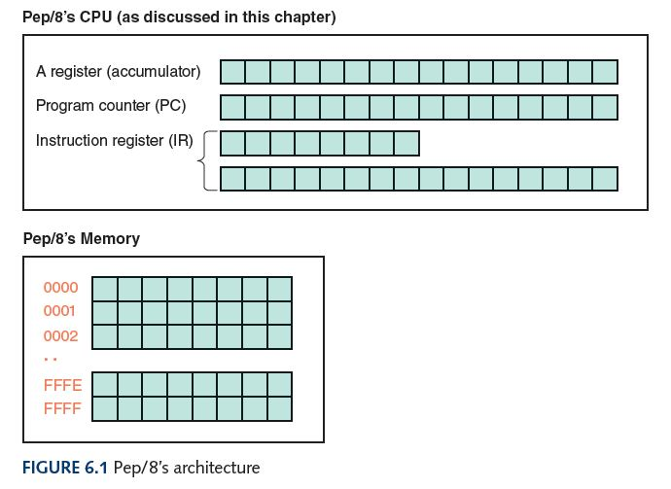
Architecture of Pep/8

Slide 11
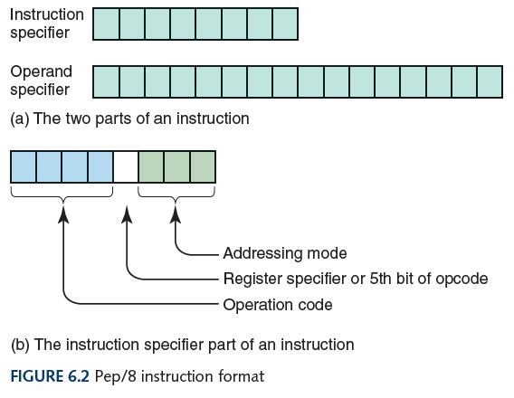
Instruction Format

Slide 12
Instruction Format
Operation code
Specifies which instruction is to be carried out
Register specifier
Specifies which register is to be used (for our purposes it always specifies the accumulator)
Addressing-mode specifier
Says how to interpret the operand part of the instruction

Slide 13
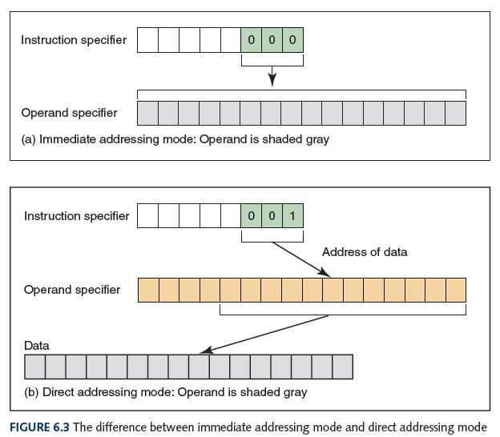
Instruction Format

Slide 14
Instruction Format
Is there something we are not telling you
about the addressing mode specifier?
How can you tell?

Slide 15
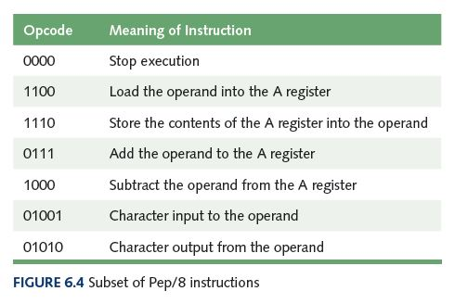
Some Sample Instructions

Slide 16
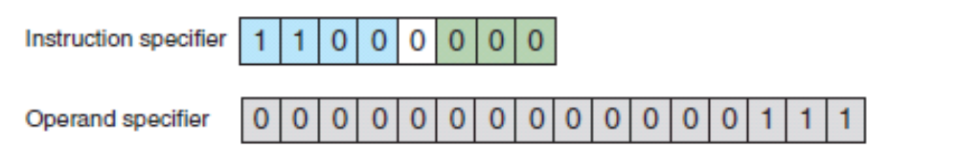
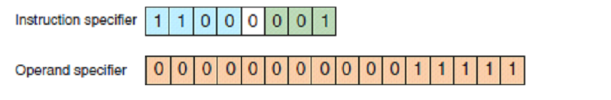
Sample Instructions
What do these instructions mean?

Slide 17
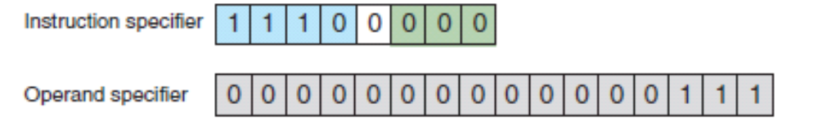
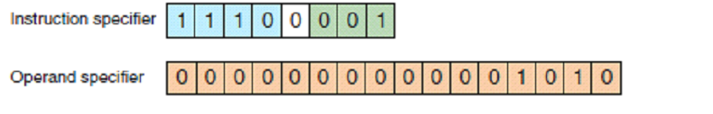
Sample Instructions
What do these instructions mean?

Slide 18


Sample Instructions
What do these instructions mean?

Slide 19
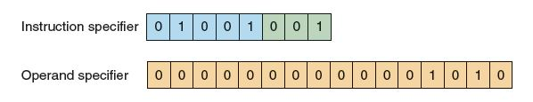
Sample Instructions
What do these instructions mean?
Why is there only one on this page?

Slide 20
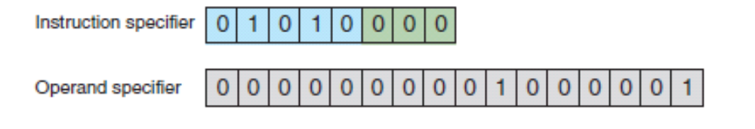
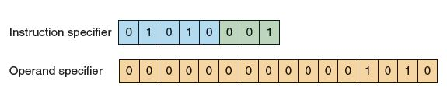
Sample Instructions
What do these instructions mean?

Slide 21
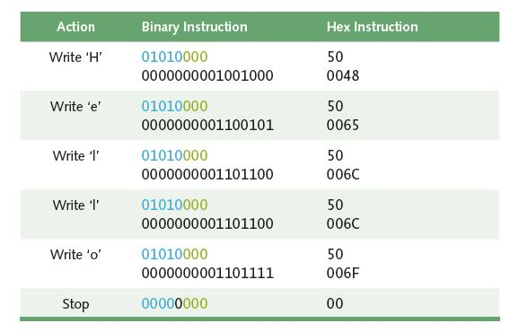
Written Algorithm of Hello

Slide 22
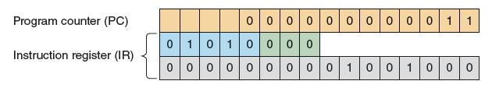
Hand Simulation
Where in the fetch/execute cycle is this?
How much is the PC incremented?

Slide 23
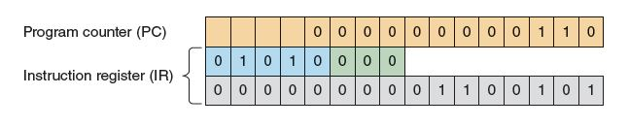
Hand Simulation
Where in the fetch/execute cycle is this?

Slide 24
Pep/8 Simulator
Pep8/Simulator
A program that behaves just like the Pep/8 virtual machine behaves
To run a program
Enter the hexadecimal code, byte by byte with blanks between each

Slide 25
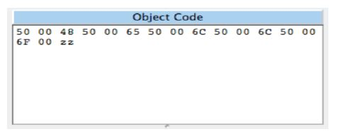
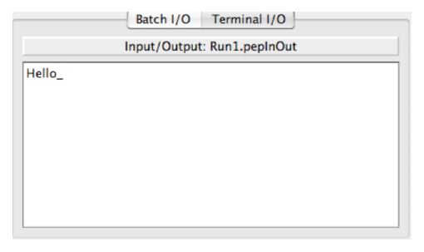
Pep/8 Simulator
What are the
"zz"s for?

Slide 26
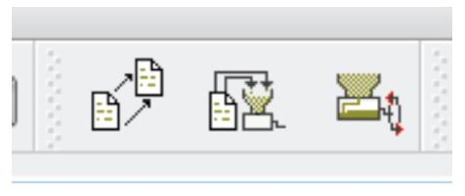
Pep/8 Simulator
execute
load
Your version may look just a bit different.

Slide 27
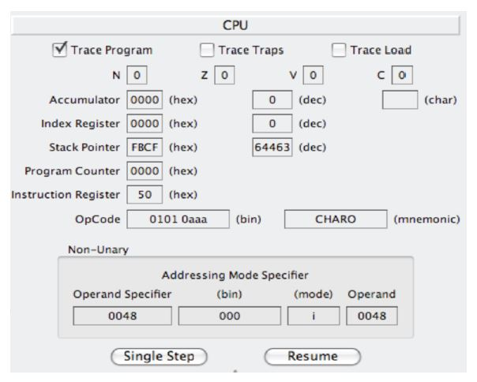
Pep/8 Simulator

Slide 28
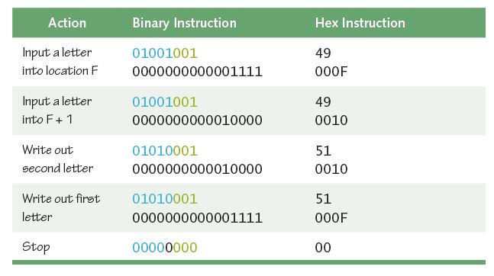
Pep/8 Simulator
What does this program do?

Slide 29
Assembly Language
Assembly language
A language that uses mnemonic codes to represent machine-language instructions
Assembler
A program that reads each of the instructions in mnemonic form and translates it into the machine-language equivalent

Slide 30
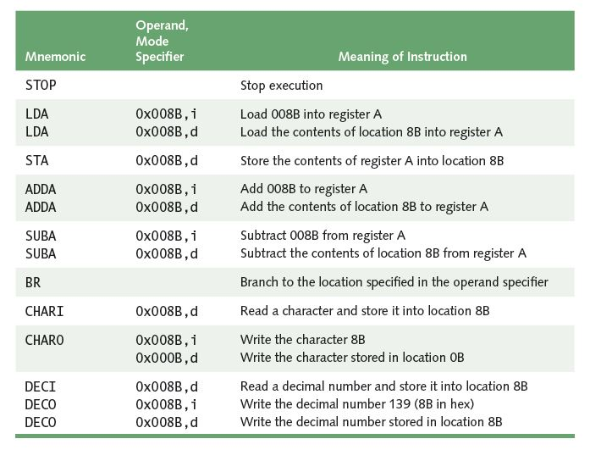
Pep/8 Assembly Language
Remember
the
difference
between
immediate
and
direct
addressing?
i : immediate
d: direct

Slide 31
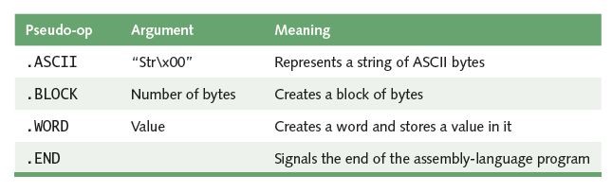
Pep/8 Assembly Language
What is the difference between
operations and pseudo operations?

Slide 32
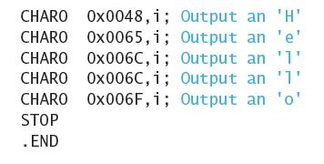
Pep/8 Assembly Language
Program "Hello"

Slide 33
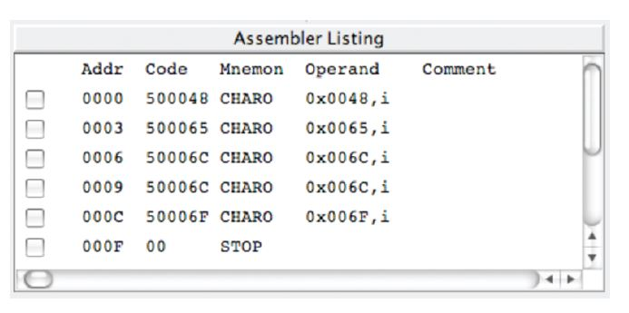
Pep/8 Assembly Language

Slide 34
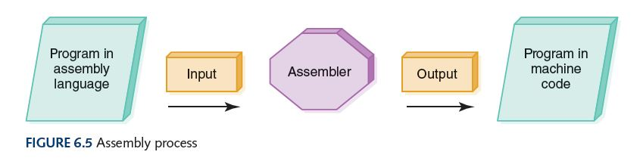
Assembly Process

Slide 35
A New Program
Problem: Read and sum three values and print the sum
How would you do it by hand?

Slide 36
Our Completed Program
    BR main
    sum: .WORD 0x0000
    num1: .BLOCK 2
    num2: .BLOCK 2
    num3: .BLOCK 2
    main: LDA sum,d
    DECI num1,d
    ADDA num1,d
    DECI num2,d
    ADDA num2,d
    DECI num3,d
    ADDA num3,d
    STA sum,d
    DECO sum,d
    STOP
    .END

Slide 37
Selection
BRLT i Set PC to operand if A < 0
BREQ i Set PC to operand if A = 0
    negMsg: CHARO 0x0045,i
    BR finish
    main: LDA sum,d
    …
    BRLT negMsg
    STA sum,d
    DECO sum,d
    finish: STOP
How many ways to finish?

Slide 38
Iteration
    Problem: Read and sum limit values.
    How many values?
    Where does this value come from?
    Will require repeating the reading and
    summing
    How do we know when we are done?

Slide 39
Pseudocode
Pseudocode
A mixture of English and formatting to make the steps in an algorithm explicit
Algorithm to Convert base-10 number to other bases
While (the quotient is not zero)
Divide the decimal number by the new base
Make the remainder the next digit to the left in the answer
Replace the original decimal number with the quotient

Slide 40
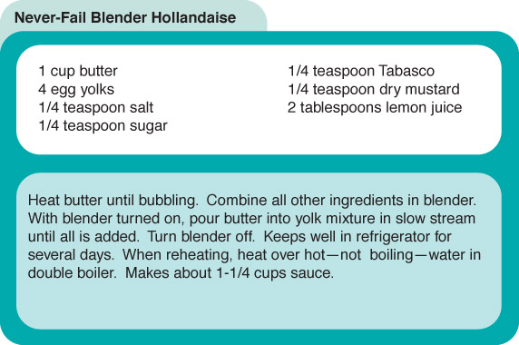
Following an Algorithm

Slide 41
Following an Algorithm
Algorithm for preparing a Hollandaise sauce
IF concerned about cholesterol
Put butter substitute in a pot
ELSE
Put butter in a pot
Turn on burner
Put pot on the burner
WHILE (NOT bubbling)
Leave pot on the burner
Put other ingredients in the blender
Turn on blender
WHILE (more in pot)
Pour contents into lender in slow steam
Turn off blender

Slide 42
Developing an Algorithm
Two methodologies used to develop computer solutions to a problem
  Top-down design focuses on the tasks to be done
  Object-oriented design focuses on the data involved in the solution
But first, let's look at a way to express algorithms: pseudocode

Slide 43
Pseudocode
Pseudocode
A way of expressing algorithms that uses a mixture of English phrases and indentation to make the steps in the solution explicit
There are no grammar rules in pseudocode, but it’s important to be consistent and unambigous

Slide 44
Following Pseudocode
While (the quotient is not zero)
Divide the decimal number by the new base
Make the remainder the next digit to the left in the answer
Replace the original decimal number with
What is 93 in base 8?
93/8 gives 11 remainder 5
11/6 gives 1 remainder 3
1/ 8 gives 0 remainder 1
answer 1 3 5

Slide 45
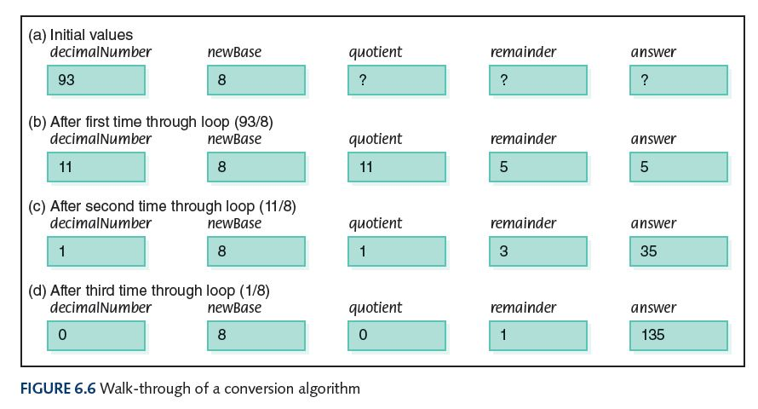
Following Pseudocode
Easier way to organize solution

Slide 46
Pseudocode for Complete Computer Solution
Write "Enter the new base"
Read newBase
Write "Enter the number to be converted"
Read decimalNumber
Set quotient to 1
WHILE (quotient is not zero)
Set quotient to decimalNumber DIV newBase
Set remainder to decimalNumber REM newBase
Make the remainder the next digit to the left in the answer
Set decimalNumber to quotient
Write "The answer is "
Write answer

Slide 47
Pseudocode Functionality
Variables
Names of places to store values
quotient, decimalNumber, newBase
Assignment
Storing the value of an expression into a
variable
Set quotient to 64
quotient <-- 64
quotient <-- 6 * 10 + 4

Slide 48
Pseudocode Functionality
Output
Printing a value on an output device
Write, Print
Input
Getting values from the outside word and storing them into variables
Get, Read

Slide 49
Pseudocode Functionality
Selection
Making a choice to execute or skip a statement (or group of statements)
Read number
IF (number < 0)
Write number + " is less than zero."
or
Write "Enter a positive number."
Read number
IF(number < 0)
Write number + " is less than zero."
Write "You didn't follow instructions."

Slide 50
Pseudocode Functionality
Selection
Choose to execute one statement (or group of statements) or another statement (or group of statements)
IF ( age < 12 )
Write "Pay children's rate"
Write "You get a free box of popcorn"
ELSE IF ( age < 65 )
Write "Pay regular rate"
ELSE
Write "Pay senior citizens rate"

Slide 51
Pseudocode Functionality
Repetition
Repeating a series of statements
Set count to 1
WHILE ( count < 10)
Write "Enter an integer number"
Read aNumber
Write "You entered " + aNumber
Set count to count + 1
How many values were read?

Slide 52
Pseudocode Example
Problem: Read in pairs of positive numbers and print each pair in order.
WHILE (not done)
Write "Enter two values separated by blanks"
Read number1
Read number2
Print them in order

Slide 53
Pseudocode Example
How do we know when to stop?
Let the user tell us how many
Print them in order?
If first number is smaller
print first, then second
Otherwise
print second, then first

Slide 54
Pseudocode Example
Write "How many pairs of values are to be entered?"
Read numberOfPairs
Set numberRead to 0
WHILE (numberRead < numberOfPairs)
Write "Enter two values separated by a blank; press return"
Read number1
Read number2
IF(number1 < number2)
Print number1 + " " + number2
ELSE
Print number2 + " " number1
Increment numberRead

Slide 55
Walk Through
Data Fill in values during each iteration
3 numberRead number1 number2
55 70
2 1
33 33
numberOfPairs
What is the output?

Slide 56
Translating Pseudocode
To What?
Assembly language
Very detailed and time consuming
High-level language
Easy, as you'll see in Chapter 9

Slide 57
Testing
Test plan
A document that specifies how many times and with what data the program must be run in order to thoroughly test it
Code coverage
An approach that designs test cases by looking at
the code
Data coverage
An approach that designs test cases by looking at the allowable data values
What does “thoroughly” mean?

Slide 58
Testing
Test plan implementation
Using the test cases outlined in the test plan to verify that the program outputs the predicted results

Slide 59
Important Threads
Operations of a Computer
Computer can store, retrieve, and process data
Computer’s Machine Language
A set of instructions the machine’s hardware is built to recognize and execute
Machine-language Programs
Written by entering a series of these instructions in binary form

Slide 60
Important Threads
Pep/8: A Virtual Computer with One Register (A) and two-part instructions:
One part tells which action the instruction performs; the other part details where the data to be used can be found
Pep/8 Assembly Language
A language that permits the user to enter mnemonic codes for each instruction rather than binary numbers
Pseudocode
Shorthand-type language people use to express algorithms

Slide 61
Important Threads
Testing Programs
All programs must be tested; code coverage testing and data coverage (black-box testing) are two common approaches

Slide 62
Ethical Issues
Software Piracy and Copyrighting
  Have you ever "borrowed" software from a friend?
  Have you ever "lent" software to a friend?
  According to IDC, lowering software piracy by 10% over the next four years would create 500,000 jobs

Slide 63
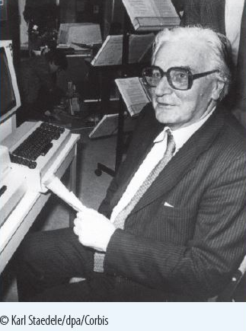
Who am I?
Turing, Atanasoff, Eckert, and Mauchly were my contemporaries. Why were we unaware of each other’s work?

Slide 64
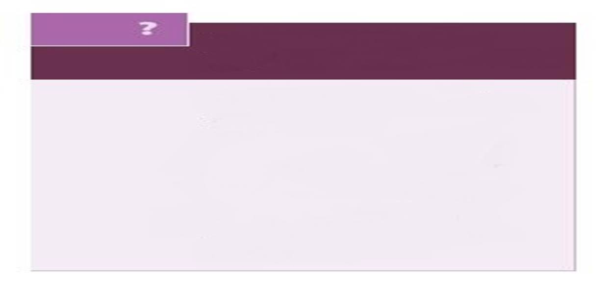
Do you know?
How is a computer data base helping endangered species?
What would chess grandmaster Jan Helm Donner do if he had a hammer?
What are Nigerian check scams?
Why does an anthropologist work for Intel?
What is the Music Genome Project?
What music streaming website uses the Music Genome Project?
What is the difference between certification and licensing?

